Slide 1



Department of Artificial Intelligence
Project Title Finalization Seminar
Winter 2023 (Session: 2023-2024)
Group Number: - G-14
Date : 20/07/2023
Title of the Project:- Strokes-Master : CricShot Analyzer and visualization using Pose Estimation
Presented By:
Renuka Deshpande (B-5)
Sakshi Nikhade (B-7)
Achal Talalwar (B-55)
Chinmay Kshirsagar (B-60)
Guide
Tony Jagysi
Assistant professor
GHRCE , Nagpur

Slide 2

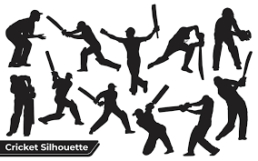
StroStrokes Master : CricShot Analyzer and visualization using Pose Estimation

Slide 3

Introduction
Cricket is one of the most watching and loved sports in current world. With the increasing craze for cricket, different countries are participating at various tournaments, leagues conducting all over the world.
Our project aims to analyze and visualize the cricket shots by using pose estimation techniques, with a specific focus on reducing the costs associated with athlete training and labeling for detection and pose estimation tasks.
Considered shots: cover drive, defensive shot, flick shot, hook, late cut, lofted shot, pull, square cut, straight drive, and sweep.

Slide 4
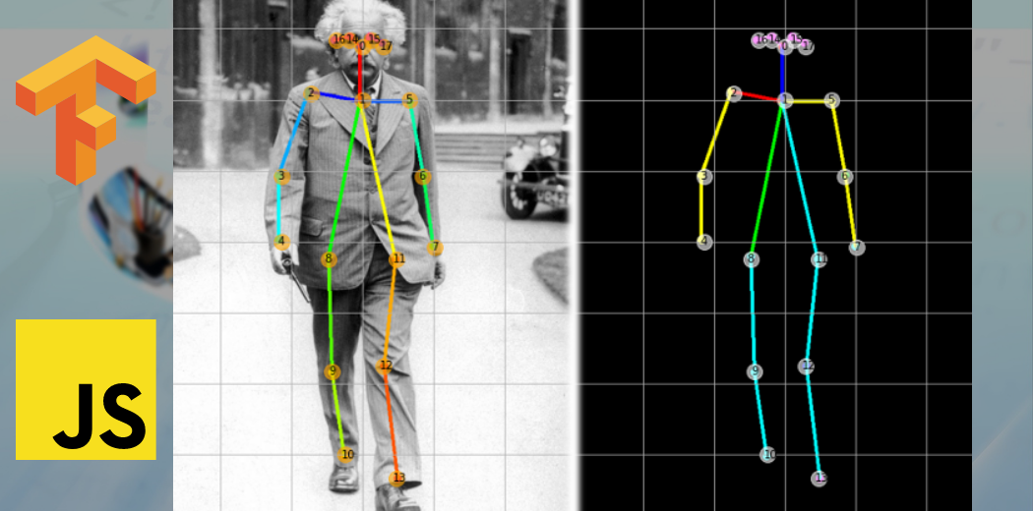
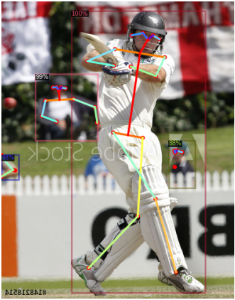
Problem Definition
Our goal is to analyze and visualize activities using our own designed model. Using data collected from the internet, our model will identify cricket shot activity as well as similarities and differences between shots.
The system would be able to process image of cricket players taking shots, extract their body landmarks, and provide insightful analytics along with visual representations of the key aspects of their shots.

Slide 5
Project Description
Objective:
To reduce the cost of training the athlete.
To reduce the cost of labelling for sports athlete detection and pose estimation tasks.
To improve the performance of athlete and human pose estimation in sports .
The goal of this project is to use pose estimation to analyze and visualize body movements and postures in cricket shot images and to create an Excel file with data and visual comparisons of both shot.
Scope :
It can be used in the fields of sports coaching and analysis, fitness tracking, medical rehabilitation, and more to provide insights into body movements and postures.
The scope is to analysis and visualize the cricket shot body movements using pose estimation, offering valuable insights for performance evaluation and coaching.

Slide 6
Benefits :
Enhancing the viewing experience: The ability to analyze batting shots from cricket can provide a more engaging and informative viewing experience for fans.
Improving player performance: The analysis of batting shots can also be used to help players improve their performance.This can lead to better performance on the field and potentially more success for team.
Advancing the field of computer vision: They can improve the accuracy and efficiency of these algorithms, which can have broad applications in fields such as healthcare, transportation, and security.

Slide 7

Abstract
This project aims to allow athletes and coaches with actionable insights that will generate continuous improvement in cricketing techniques and strategies.
Since each player has a responsibility to perform at the best, it is important to understand the game very well. Detecting cricket shots based on its characteristics will help sport analysts and coaches to understand the game very well. our model will mainly classifies the detection of athletes and human pose estimation in sports. Starting from image-based target detection and human pose estimation algorithms, combined with the characteristics of sports images, the target detection and human pose estimation models trained based on general data sets are migrated.

Slide 8
Literature Survey (Survey of existing products)
Sr.No | Title of the paper | Author | Year | Major observations/ Findings
1 | CricShotClassify: An Approach to Classifying Batting Shots from Cricket Videos Using a Convolutional Neural Network and Gated Recurrent Unit | Anik Sen, Kaushik Deb, Pranab Kumar Dhar, Takeshi Koshiba | 2021 | In this paper, a hybrid neural network architecture was proposed, and it was successfully used to classify 10 different cricket batting shots from a video using publicly accessible data sources. In order to conduct more experiments and increase accuracy, we plan to release our dataset after scaling it up with more pertinent videos.
2 | cricket shot classiﬁcation based on motion vector | Lean Karlo S. Tolentino1 , Celline P. De Pedro , Jatt D. Icamina | 2020 | For action recognition they have used 3D MACH to classify the shots and to detect cricket shots they deﬁne 8 classes of angle ranges.
3 | Classifyingc and Learning Cricket Shots Using Camera Motion | Mihai Lazarescu, Svetha Venkatesh, and Geoff West | 2019 | The authors presents a method to classify and learn cricket shots. The procedure begins by extracting the camera motion parameters from the shots. Then the camera parameter values are converted to symbolic form and combined to generate a symbolic description that defines the trajectory of the cricket ball.

Slide 9
Literature Survey (Survey of existing products)
Sr.No | Title of the paper | Author | Year | Major observations/ Findings
4 | Shot-Net: A Convolutional Neural Network for Classifying Different Cricket Shot | Md. Ferdouse Ahmed Foysal, Mohammad Shakirul Islam, Asif Karim & Nafis Neehal | 2019 | In this paper, the authors have proposed a 13 layered Convolutional Neural Network referred as “Shot-Net” in order to classifying six categories of cricket shots, namely Cut Shot, Cover Drive, Straight Drive, Pull Shot, Scoop Shot and Leg Glance Shot and the model has achieved fairly high accuracy with low cross-entropy rate.
5 | A generic approach to classify sports video shots and its application in event detection | YuJ, Lei A, Song Z, Wang T, Cai H and Feng N | 2021 | In this study, the effectiveness of supervised and unsupervised classifiers for video shot classification was examined . Methodology used here is bag of visual words model based on Scale Invariant Feature Transform (SIFT) feature points to represent the key frame for each shot; either Support Vector Machine (SVM) or Probabilistic Latent Semantic Analysis (PLSA) is then used to classify the key frame to determine shot type.
6 | Deep Learning using CNN’s for Ball-by-Ball Outcome Classiﬁcation in Sports | Dixit and Balakrishnan | 2020 | They compare the performance of three diﬀerent Convolutional Neural Network architectures, inspired by literature on activity recognition in videos

Slide 10
Proposed Methodology/System Architecture
1. Data Collection:
A. Data Source Selection: Identify and select the cricket shot images or videos that you want to analyze. Ensure they are representative of different shot types.
B. Data Acquisition: Use file dialogs (in this code, "easygui") to allow users to select the data sources .
C. Image Processing: Use OpenCV to read the selected images.
2. Pose Estimation:
A. Initialize Pose Estimator: Use the MediaPipe library to initialize the pose estimator with appropriate configuration parameters.
B. Process Frames: Iterate through each frame extracted from the data sources.
C. Convert to RGB: Convert the frame to RGB format for use with the pose estimator.
D. Pose Detection: Apply pose estimation to detect body landmarks (key points) in each frame.
3. Data Storage:
A. Create DataFrames: Create empty Data Frames to store the pose estimation data. In this code, two DataFrames (df1 and df2) are used to store data from two different sources.
B. Landmark Data Extraction: Extract the X, Y, Z coordinates, and visibility for each landmark and store it in the respective DataFrame.

Slide 11
Proposed Methodology/System Architecture
4. Data Visualization:
A. Excel Workbook Creation: Create a new Excel workbook using the openpyxl library to store the data and visualizations.
B. Data Export: Save the Data Frames to separate sheets within the Excel workbook.
C. Chart Generation: Create bar charts to visualize and compare data. In this code, bar charts for X, Y, and visibility of landmarks are generated and added to a comparison sheet.
5. Save Results:
A. Save Excel File: Save the Excel workbook with the data and visualizations. The file is named with a timestamp to ensure uniqueness.
6. Conclusion and Reporting:
A. Output: Inform users that the data has been saved to an Excel file with visualizations and comparisons.

Slide 12
System Architecture
Data Collection
Pose Estimation
Data
Storage
Conclusion and
Reporting
Save Results
Data Visualization

Slide 13
Hardware /Software Specification
Software :- Visual Code
Language:- Python
Tools and Technologies :- Computer Vision, Open-cv, media pipe
Python libraries :- Numpy, Pandas , Media pipe , Math, Easygui, os, Cv2,openpyxl

Slide 14
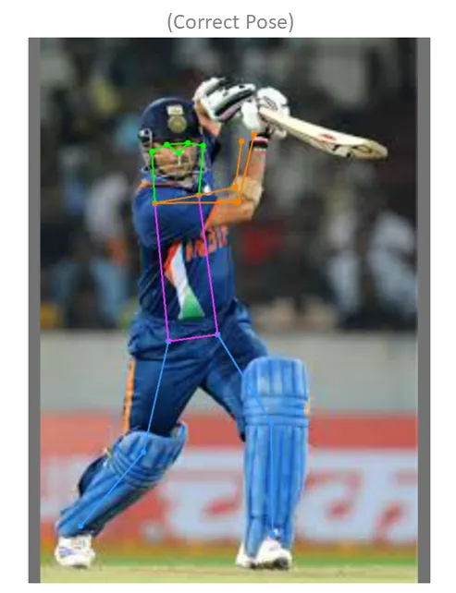
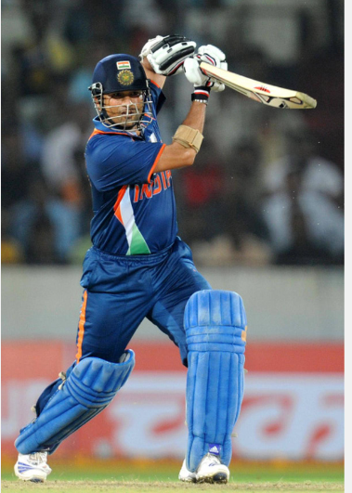
Pose Estimation

Slide 15
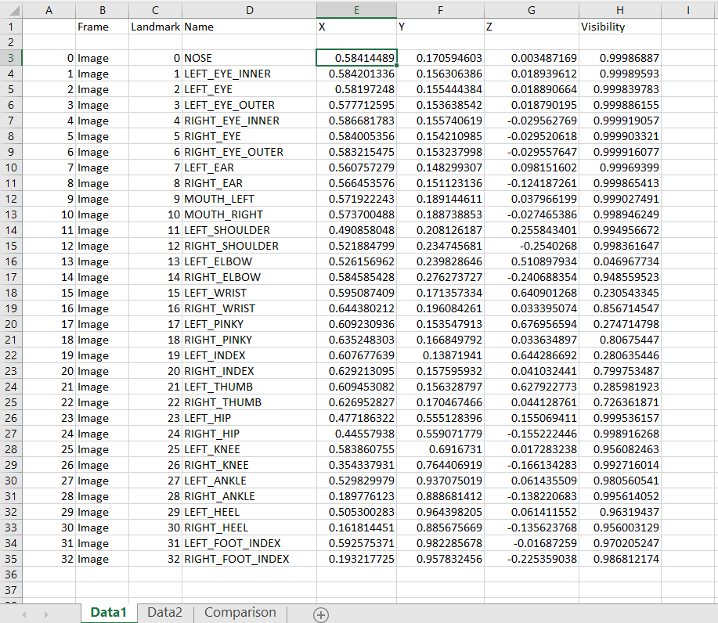
Output

Slide 16
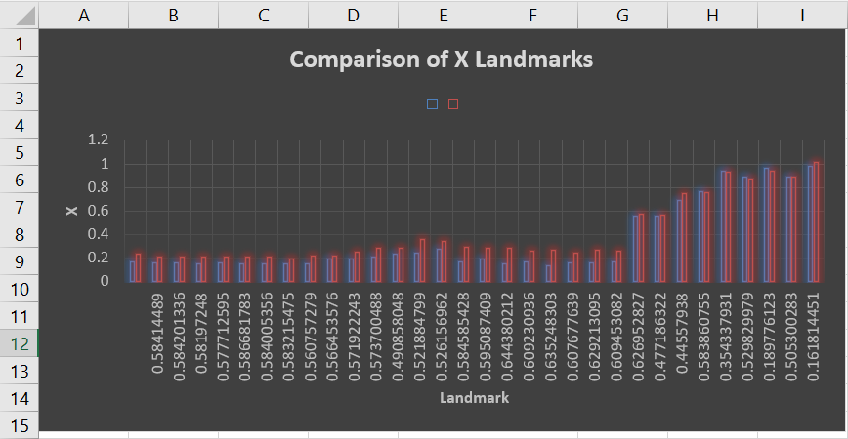

Slide 17
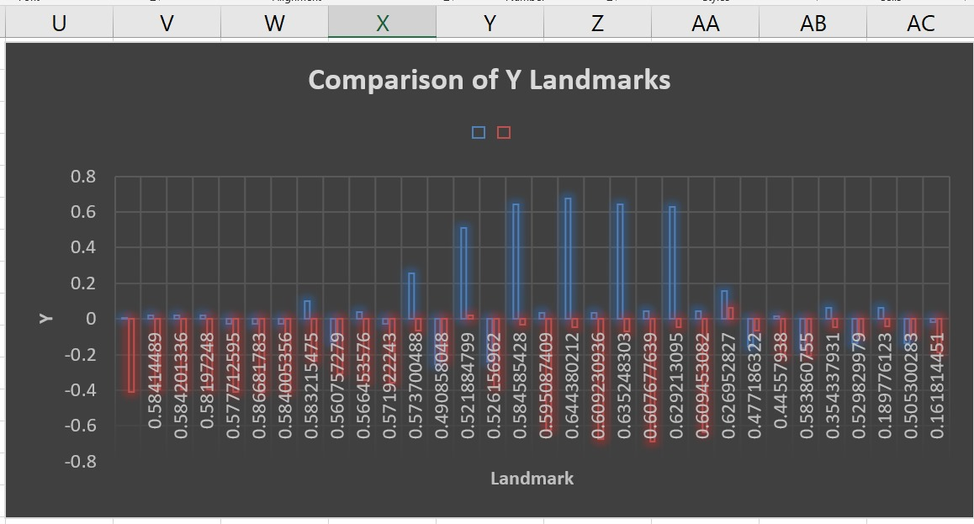

Slide 18
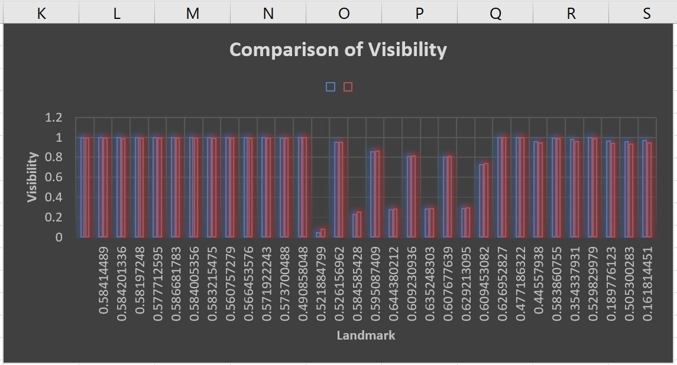

Slide 19
Future Scope
This code can be extended for more advanced analysis. For example, you can use the pose data to detect specific actions or postures, or you can integrate it with machine learning models to classify and predict certain movements or activities.
It can be used in the fields of sports coaching and analysis, fitness tracking, medical rehabilitation, and more to provide insights into body movements and postures.
The code can be integrated into real-time systems for live monitoring and feedback in applications like virtual fitness trainers or sports performance analysis tools.
Future improvements may include optimizing the code for performance, adding more advanced data visualization options, and integrating with cloud services for scalable data storage and analysis.

Slide 20
Conclusion
Our objective is to use analyze and visualize cricket shot activities. We are trying to develop model which will recognize cricket shot activity as well as similarities and differences between multiple shots using data gathered from the internet.
Coaches and players may obtain a detailed perspective of their performance metrics , which improves the user experience. The Strokes master is at the forefront of technological advancements, the way we analyse and visualise cricket strokes for better training and performance optimisation.

Slide 21
References
Anik Sen, Kaushik Deb, Pranab Kumar Dhar,Takeshi Koshiba “CricShotClassify: An Approach to Classifying Batting Shots from Cricket Videos Using a Convolutional Neural Network and Gated Recurrent Unit” (2021)
Lean Karlo S. Tolentino1 , Celline P. De Pedro , Jatt D. Icamina “cricket shot classiﬁcation based on motion vector” (2020)
Mihai Lazarescu, Svetha Venkatesh, and Geoff West “Classifyingc and Learning Cricket Shots Using Camera Motion” (2019)
Md. Ferdouse Ahmed Foysal, Mohammad Shakirul Islam, Asif Karim & Nafis Neehal “Shot-Net: A Convolutional Neural Network for Classifying Different Cricket Shot” (2019)
YuJ, Lei A, Song Z, Wang T, Cai H and Feng N “A generic approach to classify sports video shots and its application in event detection” (2021)
Dixit and Balakrishnan “Deep Learning using CNN’s for Ball-by-Ball Outcome Classiﬁcation in Sports” (2020)

Slide 22

Thank You!

